Slide 1
File Structure in a Data Science Project Industry Best Practices
Einführung
Dr. Umberto Michelucci

Slide 2
Structure your files according to the phases of your project

Slide 3
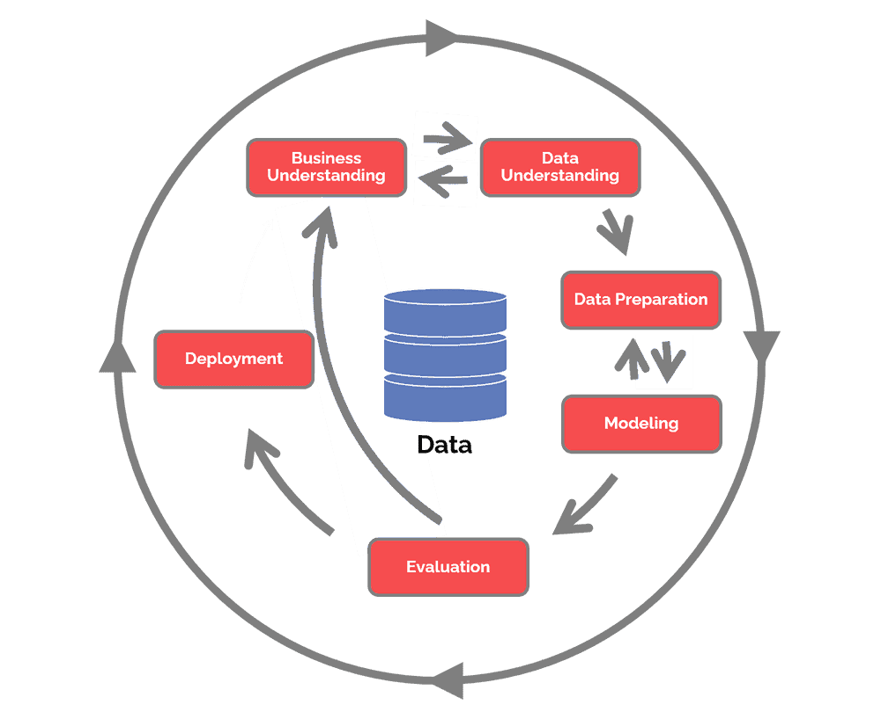
CRISP-DM - Phasen
Source: https://www.datascience-pm.com/crisp-dm-2/ (last accessed 23rd Feb. 2023)

Slide 4
Files and phases
Business understanding: a short document (word, markdown, jupyter notebook) explaining in detail what is the problem you are trying to solve)
Data understanding: at least one (maybe multiple) jupyter notebooks in which you analyse the data you plan to use. Document it well and use visualisation as much as you can.
Data preparation: at least one jupyter notebook where you perform the data cleaning and preparation. At the end save the prepared dataset to use in the next phase.
Modeling: at least one juypter notebook (or script) where you train your model. Save the results and the models that you want to evaluate here (sometime training models takes many hours, you do not want to repeat that many times).
Evaluation: at least one jupyter notebook where you document the evaluation phase.
Deployment: often multiple documents, scripts, etc. depending on the situation and the project.

Slide 5

Files / Phases
DESCRIPTION OF DATA
PROBLEM
DESCRIPTION
RAW DATA
PROCESSED DATA
MODEL / MODEL RESULTS
Jupyter Notebooks
Jupyter Notebook
Jupyter Notebook
Word Doc,
Markdown, etc.
EVALUATION RESULTS
Physical object that must be
Saved somewhere

Slide 6
Example: data folder structure
data
raw
cleaned
processed
Unmodified data with references, description, etc.
Cleaned data. For example without records with missing data.
The final dataset that will be used. Maybe multiple datasets merged, for example.

Slide 7
A couple of tips
Every jupyter notebook should run from top to end and always produce the same results.
Different experiments should be in different notebooks or save the results separately (if you want to try different dataset normalisation write separate pieces of code. DO NOT modify the code manually, save something and modify it again).
The entire project should be REPRODUCIBLE. You should be able to re-run all jupyter notebooks, from the first to the last and get the same exact results.

